Slide 1
happy
Find your synonym partner(s) and your antonym pair!

Slide 2
glad
Find your synonym partner(s) and your antonym pair!

Slide 3
sad
Find your synonym partner(s) and your antonym pair!

Slide 4
depressed
Find your synonym partner(s) and your antonym pair!

Slide 5
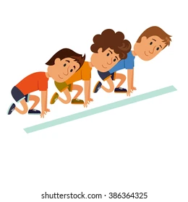
begin
Find your synonym partner(s) and your antonym pair!

Slide 6
start
Find your synonym partner(s) and your antonym pair!

Slide 7
finish
Find your synonym partner(s) and your antonym pair!

Slide 8
end
Find your synonym partner(s) and your antonym pair!

Slide 9
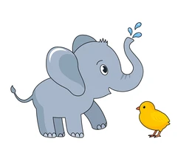
big
Find your synonym partner(s) and your antonym pair!

Slide 10
huge
Find your synonym partner(s) and your antonym pair!

Slide 11
large
Find your synonym partner(s) and your antonym pair!

Slide 12
small
Find your synonym partner(s) and your antonym pair!

Slide 13
little
Find your synonym partner(s) and your antonym pair!

Slide 14
tiny
Find your synonym partner(s) and your antonym pair!

Slide 15
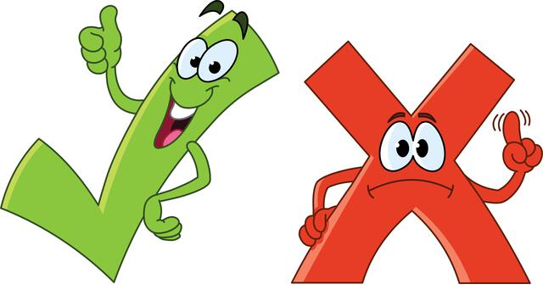
right
Find your synonym partner(s) and your antonym pair!

Slide 16
correct
Find your synonym partner(s) and your antonym pair!

Slide 17
true
Find your synonym partner(s) and your antonym pair!

Slide 18
wrong
Find your synonym partner(s) and your antonym pair!

Slide 19
incorrect
Find your synonym partner(s) and your antonym pair!

Slide 20
false
Find your synonym partner(s) and your antonym pair!

Slide 21
mad
Find your synonym partner(s) and your antonym pair!

Slide 22
angry
Find your synonym partner(s) and your antonym pair!

Slide 23
calm
Find your synonym partner(s) and your antonym pair!

Slide 24
peaceful
Find your synonym partner(s) and your antonym pair!

Slide 25
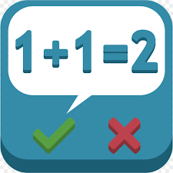
easy
Find your synonym partner(s) and your antonym pair!

Slide 26
simple
Find your synonym partner(s) and your antonym pair!

Slide 27
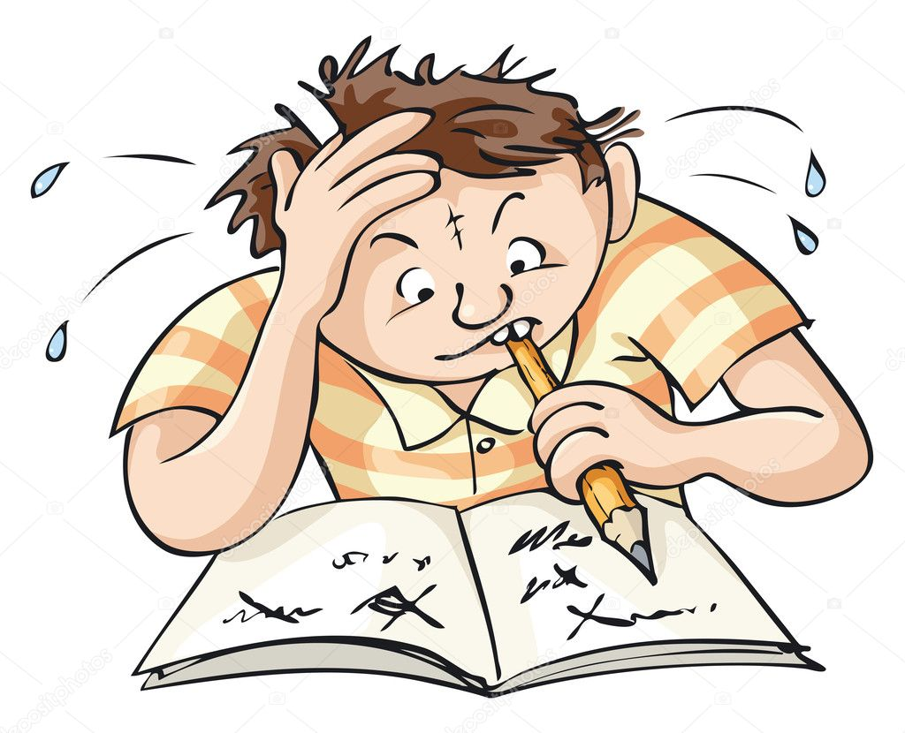
hard
Find your synonym partner(s) and your antonym pair!

Slide 28
difficult
Find your synonym partner(s) and your antonym pair!

Slide 29
over
Find your synonym partner(s) and your antonym pair!

Slide 30
above
Find your synonym partner(s) and your antonym pair!

Slide 31
under
Find your synonym partner(s) and your antonym pair!

Slide 32
below
Find your synonym partner(s) and your antonym pair!

Slide 33
tidy
Find your synonym partner(s) and your antonym pair!

Slide 34
neat
Find your synonym partner(s) and your antonym pair!

Slide 35
dirty
Find your synonym partner(s) and your antonym pair!

Slide 36
messy
Find your synonym partner(s) and your antonym pair!

Slide 37
quiet
Find your synonym partner(s) and your antonym pair!

Slide 38
silent
Find your synonym partner(s) and your antonym pair!

Slide 39
noisy
Find your synonym partner(s) and your antonym pair!

Slide 40
loud
Find your synonym partner(s) and your antonym pair!

